Slide 1

Paper Presentation CS583: Deep Learning (Fall 2021) Learning from eXtreme Bandit Feedback
Submitted by: Aditi Duggal
CWID: 10460663
Submitted to: Jia Xu

Slide 2
OVERVIEW
Problem statement and background
Learning from eXtreme Bandit Feedback
Experiments and results
Future prospects

Slide 3
Problem Statement
Supervised learning frameworks such as eXtreme Multi-lable Classification are used in large-scale real-world problems but they incur significant biases.
The biases can be mitigated by importance sampling techniques, when extending to large action spaces these techniques suffer from impractical variances.
The selective importance sampling estimator (sIS) is developed in this paper, which operates in a more favorable bias-variance environment.

Slide 4
Background
eXtreme Multi-Label Classificaton
Bandit Feedback
Propensity overfitting
Self-Normalized importance sampling
BanditNet

Slide 5
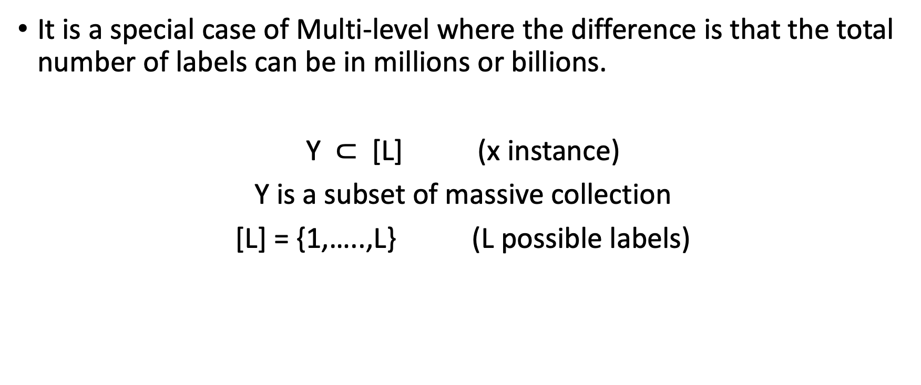
eXtreme Multi-label Classification (XMC)
It is a special case of Multi-level where the difference is that the total number of labels can be in millions or billions.
Y $⊂$ [L] (x instance)
Y is a subset of massive collection
[L] = {1,…..,L} (L possible labels)

Slide 6
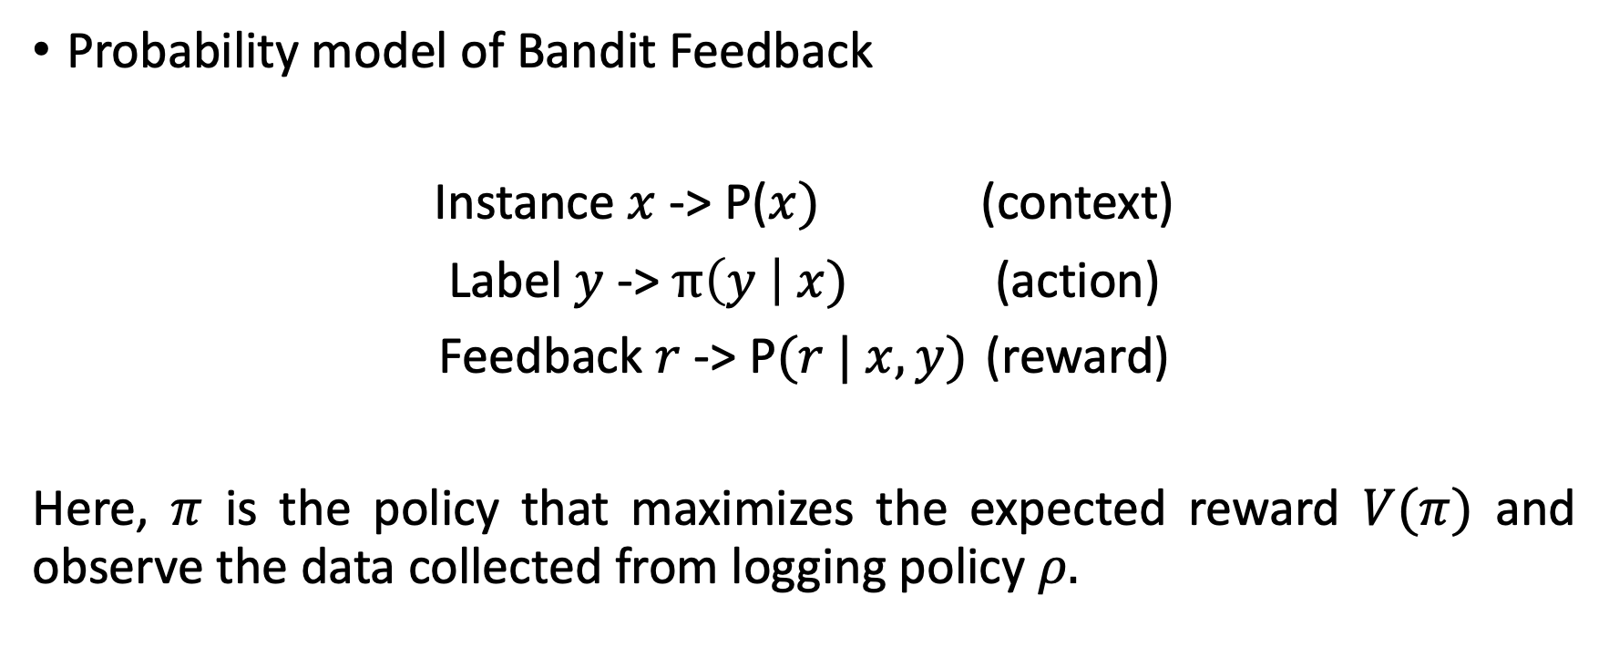
Bandit Feedback
Probability model of Bandit Feedback
Instance $x$ -> P($x)$ (context)
Label $y$ -> $π\left(y \right| x)$ (action)
Feedback $r$ -> P$(r | x,y)$ (reward)
Here, $π$ is the policy that maximizes the expected reward $V(π)$ and observe the data collected from logging policy $ρ.$

Slide 7
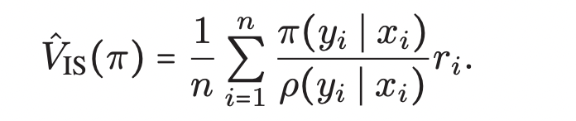
Bandit Feedback (contd.)
The importance sampling (IS) is used to estimate V(π) from data based on the logging policy.
Identifying the optimal policy via this estimator is infeasible without a thorough exploration of the action space by the logging policy

Slide 8
Propensity Overfitting
In maximizing the expected reward V (π) of a policy π, the importance sampling estimator incurs serious statistical problems called Propensity.
If the rewards are not scaled properly, the policy may avoid actions in the training set
max π

Slide 9
Self-Normalized important sampling
To overcome the problem of propensity Swaminathan and Joachims (2015b) tackled this problem via the self-normalized importance sampling estimator (SNIS)
The estimator invariant to translation of the rewards
Used as a safeguard against propensity overfitting

Slide 10
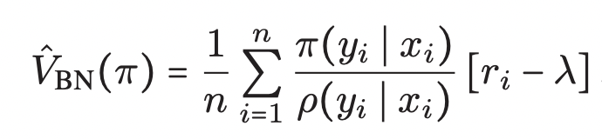
BanditNet
The SNIPS estimator is not amenable to stochastic optimization. Swaminathan and Joachims proposed BanditNet
This estimator is equivariant, meaning that it is robust to additive shifts in the reward distribution
The normalization also acts as a multiplicative control variate for variance reduction.

Slide 11
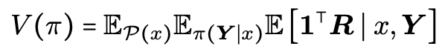
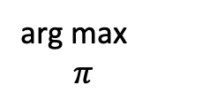
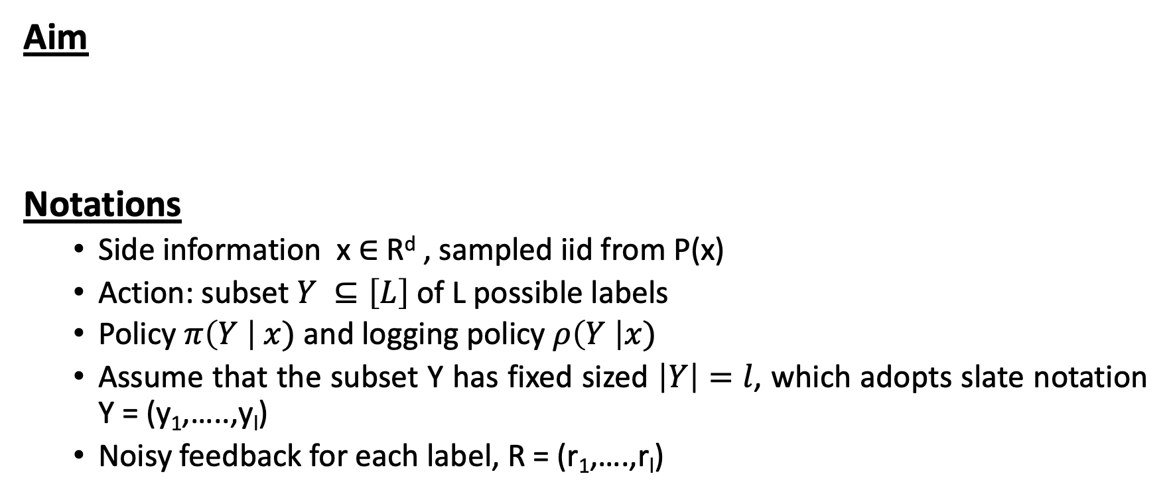
Bandit Feedback for Multi-label Classification
Aim
Notations
Side information x ∈ R^{d} , sampled iid from P(x)
Action: subset $Y ⊆\left[L\right]$of L possible labels
Policy $π\left(Y \right| x)$and logging policy $ρ\left(Y \right|x)$
Assume that the subset Y has fixed sized $\left|Y\right|=l$, which adopts slate notation Y = (y₁,…..,y_{l})
Noisy feedback for each label, R = (r₁,….,r_{l})
arg max $π$

Slide 12
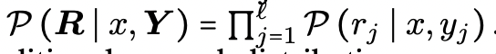
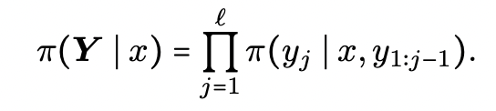
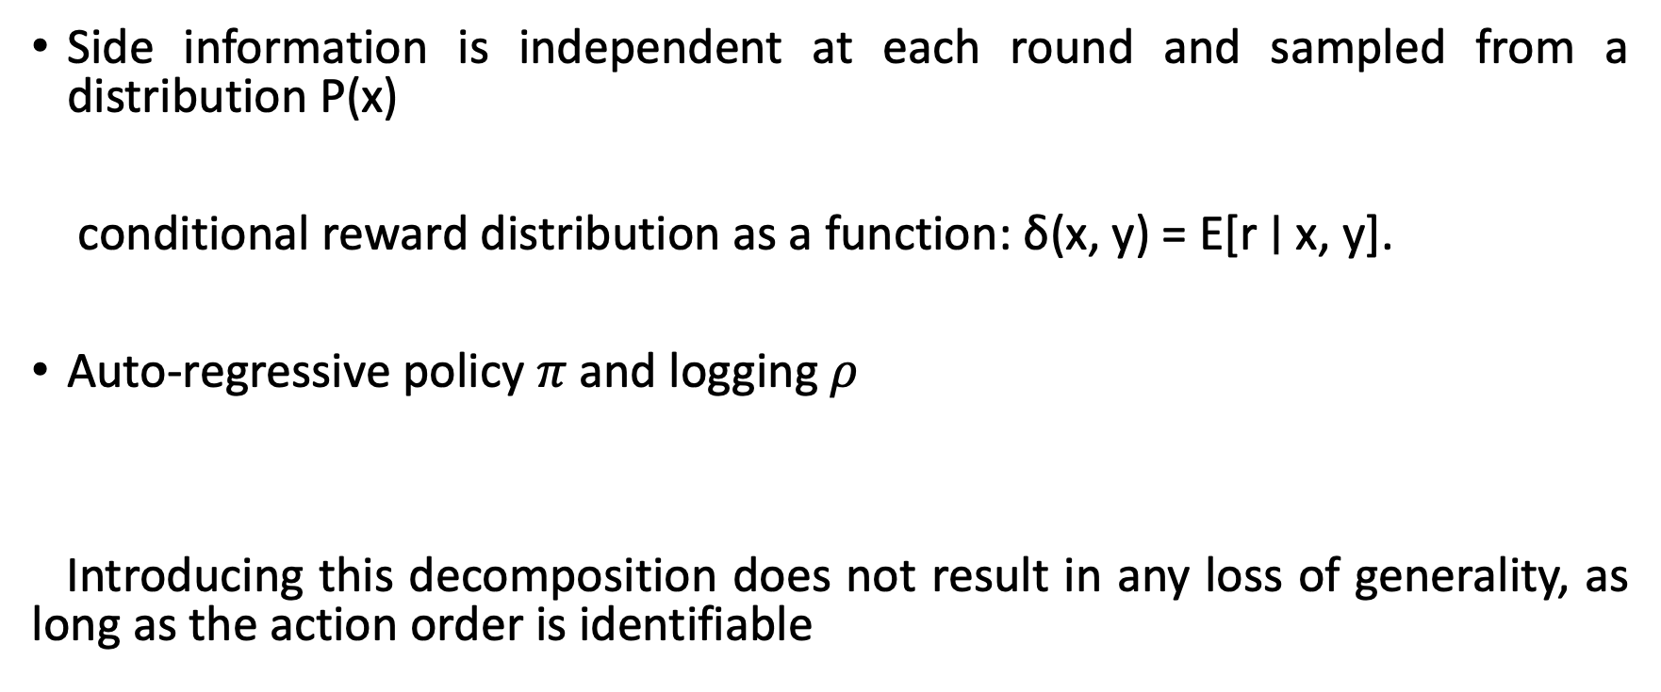
Assumptions
Side information is independent at each round and sampled from a distribution P(x)
conditional reward distribution as a function: δ(x, y) = E[r ∣ x, y].
Auto-regressive policy $π$ and logging $ρ$
Introducing this decomposition does not result in any loss of generality, as long as the action order is identifiable

Slide 13
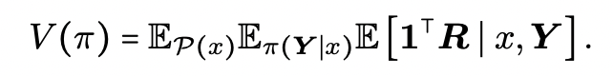
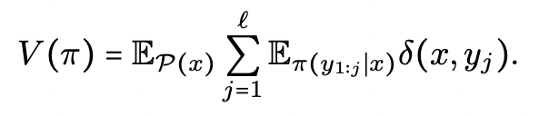
Multi-label and importance sampling
General approach
The combinatorial size of the action space yield an impractical variance for importance sampling.
Reformulated policy value
We can now use IS estimators, with a better bias-variance tradeoff, but not suitable for large action spaces.

Slide 14
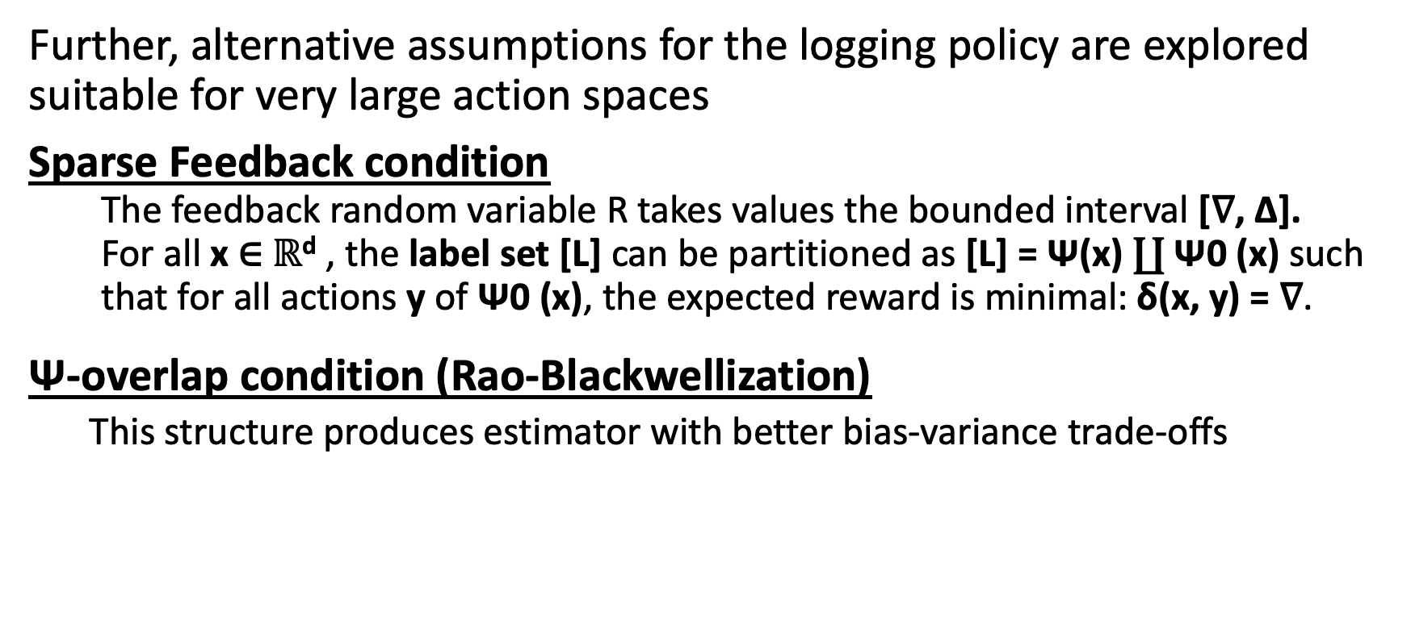
Learning from eXtreme Bandit Feedback
Further, alternative assumptions for the logging policy are explored suitable for very large action spaces
Sparse Feedback condition
The feedback random variable R takes values the bounded interval [∇, ∆].
For all x ∈ $ℝ$^{d} , the label set [L] can be partitioned as [L] = Ψ(x) ∐ Ψ0 (x) such
that for all actions y of Ψ0 (x), the expected reward is minimal: δ(x, y) = ∇.
Ψ-overlap condition (Rao-Blackwellization)
This structure produces estimator with better bias-variance trade-offs

Slide 15
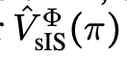
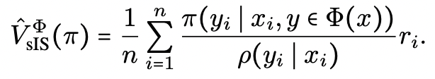
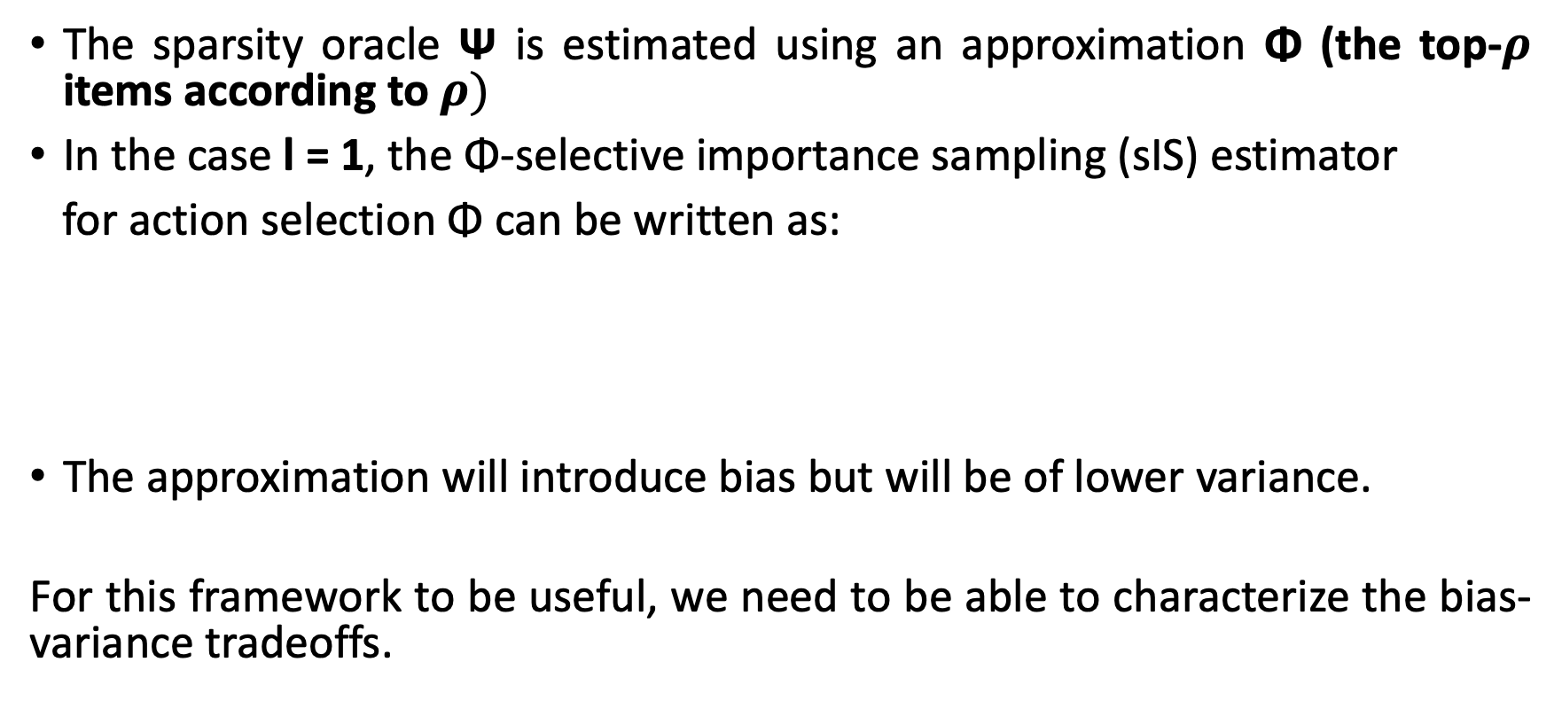
Φ-selective importance sampling estimator
The sparsity oracle Ψ is estimated using an approximation Φ (the top-$ρ$ items according to $ρ)$
In the case l = 1, the Φ-selective importance sampling (sIS) estimator
for action selection Φ can be written as:
The approximation will introduce bias but will be of lower variance.
For this framework to be useful, we need to be able to characterize the bias-variance tradeoffs.

Slide 16
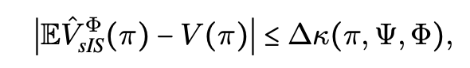
Bias-Variance Tradeoffs
The role of Φ is to prune out actions to maintain an optimal bias-variance tradeoff.
The logging policy ρ satisfies Ψ(x) ⊂ supp ρ(⋅ ∣ x)
Φ is an action selector Φ(x) ⊂ supp ρ(⋅ ∣ x)
Theorem: Bias-variance tradeoff of selective importance sampling
The bias of the sIS estimator is:
where κ(π,Ψ, Φ) = EP(x)π (Ψ(x) ∩ Φ 0 (x) ∣ x) quantifies the overlap between Ψ and Φ, weighted by the policy π

Slide 17
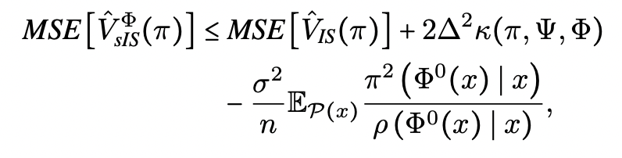
Bias-Variance Tradeoffs-Mean square error
The performance of the two estimators (IS and Φ-IS) can be compared as follows:

Slide 18
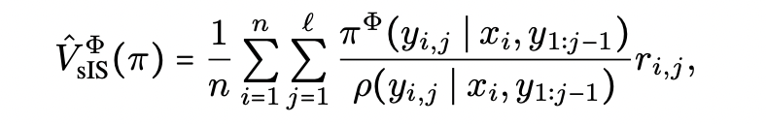
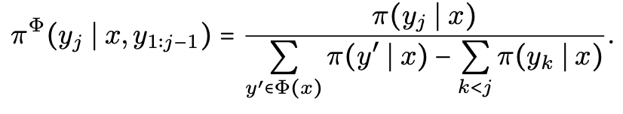
Policy Optimization for eXtreme Models (POXM)
We apply the Φ-IS estimator to the multi-label case:
Using sampling without replacement, all the conditional probabilities can be computed seamlessly from marginals
Additional control variate for variance reduction (BanditNet) is used and applied to policy gradients.

Slide 19
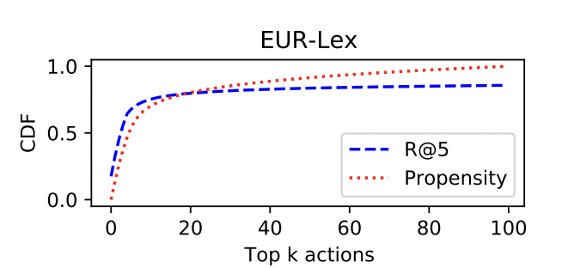
Experiments
To assess performance using several eXtreme Multi-label datasets, AttentionXML is used on a small fraction of dataset to generate a logging policy.
Expected reward at top 5 actions (R@5)
and CDF of the logging policy for the top-k
action. Exploration is limited to a subset of
relevant actions.

Slide 20
Experiments (contd.)
POXM is compared to several baselines:
Directed Method – a supervised learning baseline where AttentionXML is trained with a partial classification loss
BanditNet – attentionXML is trained without conditioning on action set Φ.
BanditNet-PM – same as BanditNet but we ignore feedback from actions that are not in Φ.

Slide 21
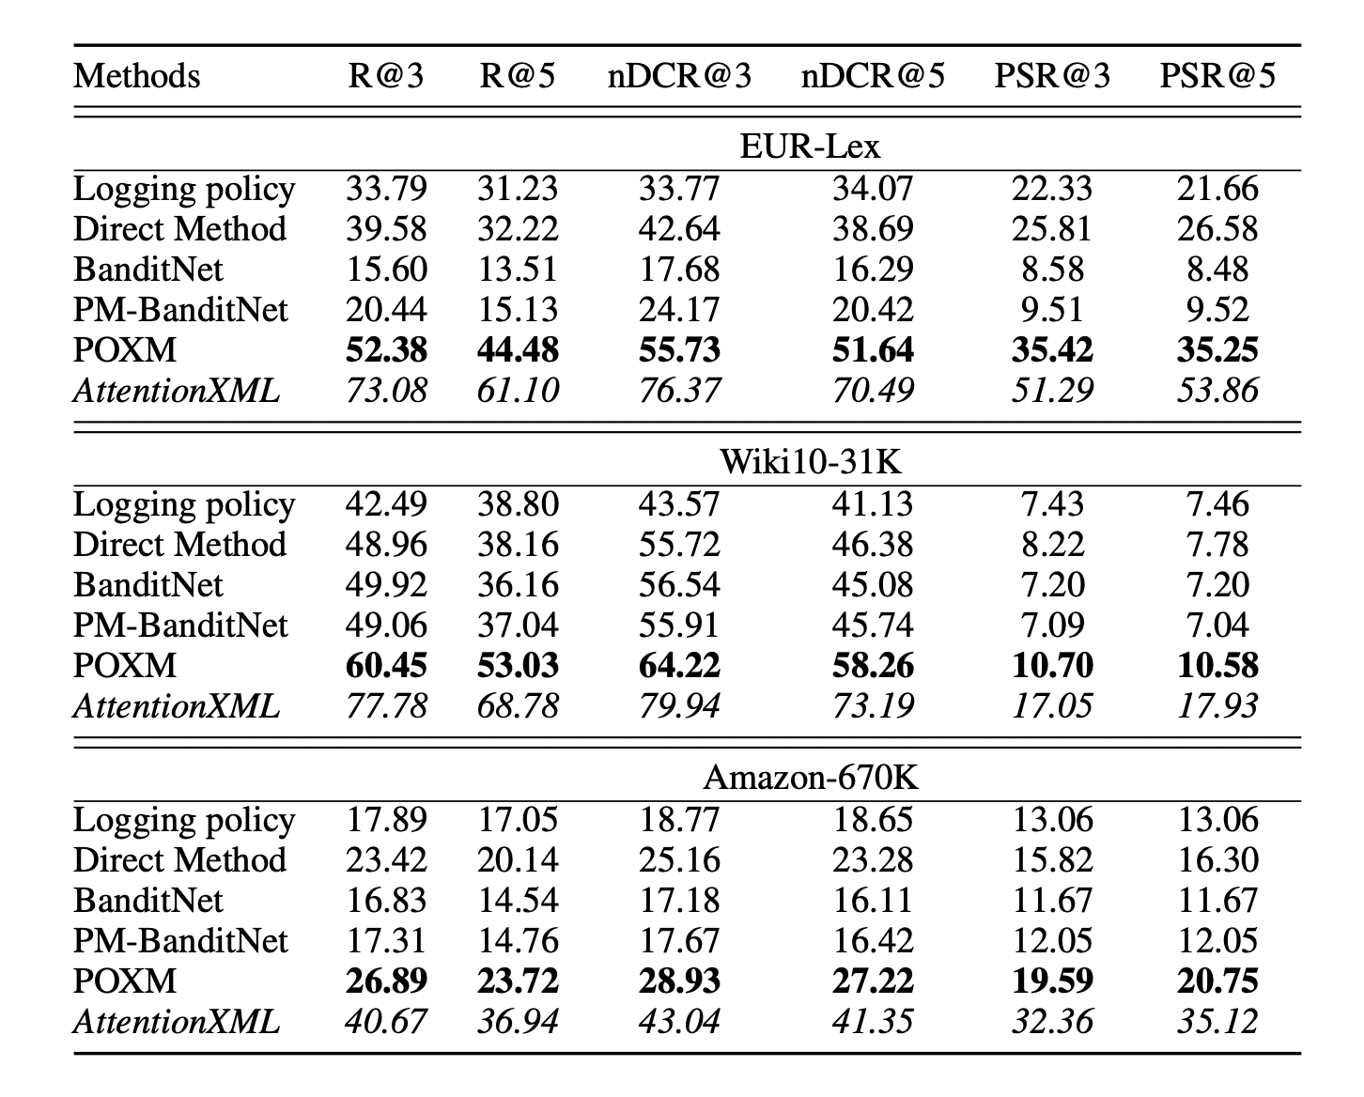
Experiment results

Slide 22
Future prospects
Investigating more structured prediction approaches to reach supervised learning.
Generalized beyond the AttentionXML
How over pruning can be prevented

Slide 23
THANK YOU !

